Slide 1


WSQ
AI SECURITY
TRAINER SLIDES · WSQ
AI Security for Autonomous AI Agents
WSQ Course Code: TGS-2025060473 · 2 Days · 16 Hours
Skills Framework TSC: Generative AI Principles and Applications (ICT-INT-0052-1.1)
Conducted by Tertiary Infotech Pte Ltd · UEN 20120096W
Version 2.1 · 20 August 2026
© 2026 Tertiary Infotech Pte Ltd. All Rights Reserved. · www.tertiarycourses.com.sg

Slide 2
00
COURSE ADMINISTRATION
Welcome & Housekeeping
AI Security for Autonomous AI Agents · TGS-2025060473
© 2026 Tertiary Infotech Pte Ltd
2

Slide 3
TRAQOM · SSG DIGITAL ATTENDANCE
Digital Attendance (Mandatory)
• It is mandatory to take the AM, PM and Assessment digital attendance for WSQ-funded courses.
• The trainer or administrator displays the digital attendance QR code from the SSG portal.
• Scan the QR code with your mobile phone camera and submit your attendance.
• A minimum of 75% attendance is required to be eligible for assessment and funding.
• Complete the TRAQOM survey at the end of the course — it is required for funding.
AI Security for Autonomous AI Agents · TGS-2025060473
© 2026 Tertiary Infotech Pte Ltd
3

Slide 4
YOUR TRAINER · GENERAL
About the Trainer
NAME
____________________________________________
?
TITLE / DESIGNATION
____________________________________________
QUALIFICATIONS
____________________________________________
Your Trainer
AREAS OF EXPERTISE
____________________________________________
General Trainer template — to be completed by the trainer
TRAINING & INDUSTRY EXPERIENCE
____________________________________________
CONTACT
____________________________________________
AI Security for Autonomous AI Agents · TGS-2025060473
© 2026 Tertiary Infotech Pte Ltd
4

Slide 5
YOUR TRAINER
About the Trainer
ROLE
Principal Trainer, Tertiary Infotech Pte Ltd
AA
BACKGROUND
PhD — 20+ years across AI, cybersecurity, data science and enterprise IT.
Dr Alfred Ang
DELIVERS
WSQ courses on generative AI, AI security, AI governance and data analytics.
Principal Trainer Tertiary Infotech Pte Ltd
FOUNDER
Founder and lead instructor at Tertiary Infotech / Tertiary Courses.
AI Security for Autonomous AI Agents · TGS-2025060473
© 2026 Tertiary Infotech Pte Ltd
5

Slide 6
ICE-BREAKER
Let's Know Each Other
• Your name, organisation and role.
• Any generative AI or AI agent systems already live in your organisation.
• One AI security question you want answered by the end of Day 2.
AI Security for Autonomous AI Agents · TGS-2025060473
© 2026 Tertiary Infotech Pte Ltd
6

Slide 7
HOUSEKEEPING
Ground Rules
Set your mobile phone to silent mode.
Participate actively — no question is too small.
Mutual respect: agree to disagree.
One conversation at a time.
Be punctual; return from breaks on time.
75% attendance is required for funding.
AI Security for Autonomous AI Agents · TGS-2025060473
© 2026 Tertiary Infotech Pte Ltd
7

Slide 8

COURSE PORTAL · LMS/TMS
Download Course Material
https://lms-tms.tertiaryinfotech.com
Sign in
lms-tms.tertiaryinfotech.com — log in with your registered email (OTP or password).
1
Open your course
Select 'AI Security for Autonomous AI Agents' under My Courses.
2
Download materials
Trainer slides and the Learner Guide — your open-book references.
3
Submit & survey
Upload your assessment answers and complete the TRAQOM survey.
4
All course material is downloaded from the LMS/TMS portal — keep it handy: the final assessment is open book.
AI Security for Autonomous AI Agents · TGS-2025060473
© 2026 Tertiary Infotech Pte Ltd
8

Slide 9
WSQ ALIGNMENT
Skills Framework Alignment
TSC element
Detail
TSC Title
Generative AI Principles and Applications
TSC Code
ICT-INT-0052-1.1
Proficiency Level
Level 1
Knowledge statements
K1–K5 — assessed by the Written Assessment
Ability statements
A1–A5 — assessed by the Case Study
This course delivers the accredited TSC through an AI security lens.
AI Security for Autonomous AI Agents · TGS-2025060473
© 2026 Tertiary Infotech Pte Ltd
9

Slide 10
WHAT YOU WILL ACHIEVE
Learning Outcomes
LO
Learning Outcome
Assessed by
LO1
Demonstrate generative AI concepts and applications relevant to customer service and hospitality management.
WA · Case Study
LO2
Apply prompt engineering techniques and analyse output variations to improve generative AI performance in service settings.
WA · Case Study
LO3
Identify ethical risks and analyse bias in AI-generated content used in customer engagement.
WA · Case Study
AI Security for Autonomous AI Agents · TGS-2025060473
© 2026 Tertiary Infotech Pte Ltd
10

Slide 11
ASSESSED BY THE WRITTEN ASSESSMENT
Knowledge Statements (K)
Code
Knowledge statement
K1
Importance of data quality, preprocessing, model pipeline and model training (e.g., impact of data bias from training data)
K2
Underlying principles, core concepts and theories governing generative AI
K3
Difference between generative and discriminative models
K4
Impact of prompt engineering on the model outputs of generative AI
K5
Generative AI model workings, including training data, algorithms, and outputs
One written assessment question per knowledge statement.
AI Security for Autonomous AI Agents · TGS-2025060473
© 2026 Tertiary Infotech Pte Ltd
11

Slide 12
ASSESSED BY THE CASE STUDY
Ability Statements (A)
Code
Ability statement
A1
Analyse limitations and potential biases in AI-generated content
A2
Identify the ethical implications and societal impact of AI-generated content
A3
Apply understanding of generative AI principles to use cases
A4
Demonstrate the use of generation AI in diverse applications (e.g., summarisation, inference, reasoning, transformation of content, augmentation of content)
A5
Analyse generative AI models' performance metrics and evaluate the influence of prompt variations
The case study covers every ability statement across three questions.
AI Security for Autonomous AI Agents · TGS-2025060473
© 2026 Tertiary Infotech Pte Ltd
12

Slide 13
SCHEDULE · DAY 1
Lesson Plan — Day 1
Morning — foundations
Afternoon — the prompt layer
• Morning (AM attendance)
– Welcome, introductions, learning outcomes
– LU1 T1: The AI security threat landscape
– LU1 T2: Generative vs discriminative — the guardrail pattern
– Tea break
– LU1 T3: Application modes as attack surfaces
– Activity 1: Threat Modelling a GenAI Concierge (45 min)
– Lunch break 12:30–1:30pm
• Afternoon (PM attendance)
– LU2 T1: Data quality, poisoning and supply chain integrity
– LU2 T2: Prompt injection — direct, indirect, cross-modal
– Tea break
– Activity 2: Prompt Injection & the PDPA Leak (60 min)
– Day 1 recap and Q&A
8 instructional hours · 9:30am–6:30pm · 1-hour lunch · tea breaks counted within.
AI Security for Autonomous AI Agents · TGS-2025060473
© 2026 Tertiary Infotech Pte Ltd
13

Slide 14
SCHEDULE · DAY 2
Lesson Plan — Day 2
Morning — frameworks & measurement
Afternoon — agents, governance, assessment
• Morning (AM attendance)
– LU2 T3: Security frameworks for GenAI and agents
– LU2 T4: Measuring guardrails — adversarial testing
– Tea break
– Activity 3: Selecting a Security Framework (60 min)
– Lunch break 12:45–1:45pm
• Afternoon (PM attendance)
– LU3 T1: Agent anatomy, excessive agency, destructive execution
– Activity 4: Rogue Agent Post-Incident Review (60 min)
– LU3 T2: PDPA, PDPC and IMDA agentic governance
– LU3 T3: Misinformation, bias and limitations
– Activity 5: Agent Governance & Deployment Gate (25 min)
– Briefing for Assessment · WA + Case Study · TRAQOM
8 instructional hours · 9:30am–6:30pm · assessment held at the end of Day 2.
AI Security for Autonomous AI Agents · TGS-2025060473
© 2026 Tertiary Infotech Pte Ltd
14

Slide 15
01
DAY 1 · LEARNING UNIT 1
Foundations of AI Security
Why generative AI breaks the security assumptions you already rely on
AI Security for Autonomous AI Agents · TGS-2025060473
© 2026 Tertiary Infotech Pte Ltd
15

Slide 16
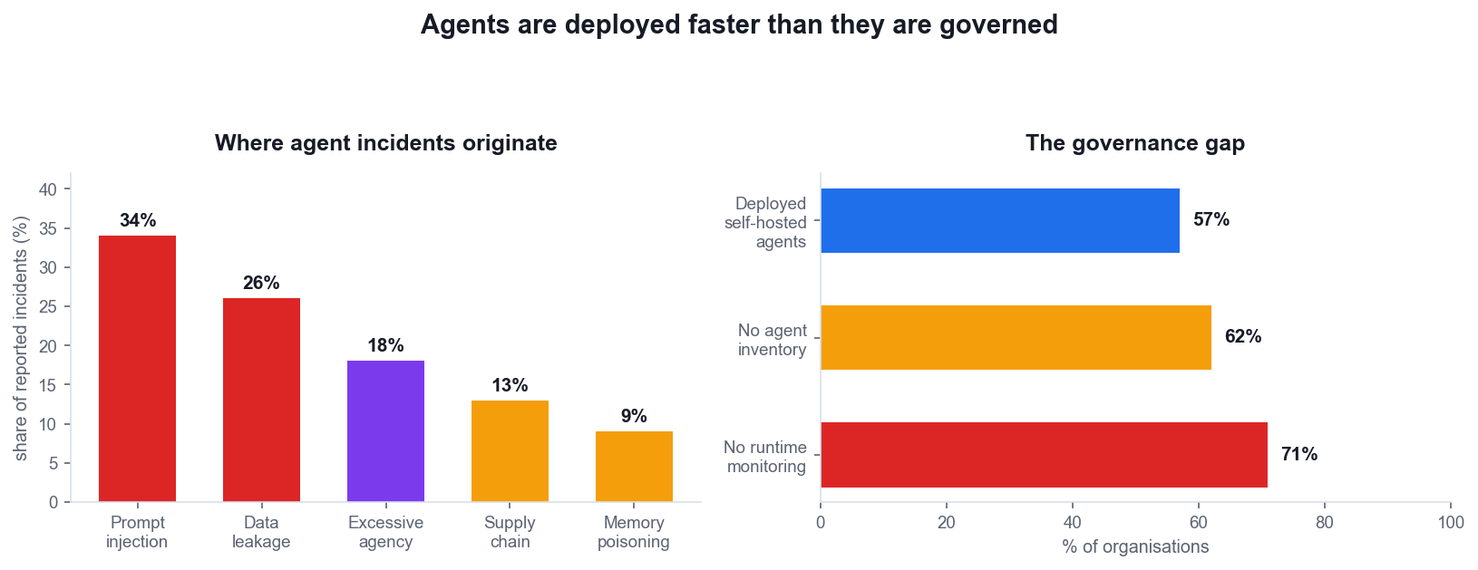
LU1 · T1 · WHERE WE ARE
The governance gap
Deployed faster than governed
57% of organisations run self-hosted agents; most have no inventory of them.
Prompt injection dominates
The single largest source of reported GenAI and agent incidents.
Excessive agency is rising
Mainstream agent deployment moved LLM03 up three places in 2026.
Monitoring is the biggest gap
71% have no runtime monitoring of what their agents actually do.
AI Security for Autonomous AI Agents · TGS-2025060473
© 2026 Tertiary Infotech Pte Ltd
16

Slide 17
LU1 · T1 · K2
Why GenAI breaks classical security
1
Input is executable
2
The boundary is learned
3
Output drives action
4
Non-determinism
Text the model reads can change what the model does. Classical apps separate code from data; LLMs do not.
Instruction/data separation is a training convention, not an enforced boundary. It degrades under pressure.
When output feeds a tool, a browser or a shell, a wrong answer becomes a wrong action.
The same input can yield different behaviour. Signature-based detection has nothing stable to match.
Classical AppSec assumes code and data are separable. A language model is the counter-example: its data IS its instructions.
AI Security for Autonomous AI Agents · TGS-2025060473
© 2026 Tertiary Infotech Pte Ltd
17

Slide 18
THE CENTRAL PROBLEM
Anything your model reads, your model can be told by.
This is a property of the architecture, not a bug awaiting a patch.
AI Security for Autonomous AI Agents · TGS-2025060473
© 2026 Tertiary Infotech Pte Ltd
18

Slide 19
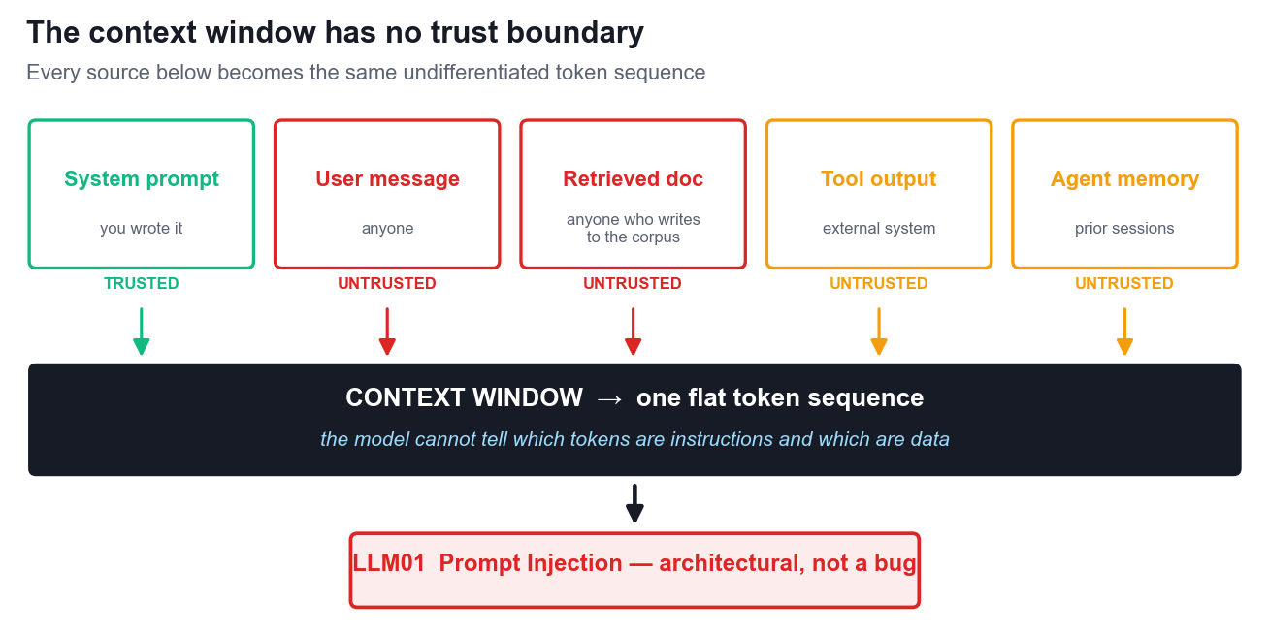
LU1 · T1 · K2
The context window has no trust boundary
Every source becomes one flat token sequence. The model cannot tell an instruction from data — which is why LLM01 has no complete fix.
AI Security for Autonomous AI Agents · TGS-2025060473
© 2026 Tertiary Infotech Pte Ltd
19

Slide 20
LU1 · T2 · K3
Generative vs discriminative models
Generative — what we secure
Discriminative — what does the policing
• Generative model
– Learns P(x) — how the data is distributed
– Produces new content: text, code, images
– The thing being secured
– Attack surface: injection, poisoning, leakage
– Cannot reliably police itself
• Discriminative model
– Learns P(y|x) — a decision boundary
– Classifies: safe / unsafe, PII / not PII
– The thing doing the policing
– Used for guardrails, filters, DLP, anomaly detection
– Fails on paraphrase, encoding and cross-modal payloads
Guardrails are worth having and must never be the only thing between an attacker and an irreversible action.
AI Security for Autonomous AI Agents · TGS-2025060473
© 2026 Tertiary Infotech Pte Ltd
20

Slide 21
LU1 · T3 · A4
Application modes are attack surfaces
Application mode
What it does
How it is abused
OWASP
Summarisation
Condenses a document or thread
Hidden instructions in the source are obeyed
LLM01
Inference
Draws conclusions about a user
Probing extracts another person's data
LLM02
Reasoning
Multi-step problem solving
Runaway loops burn the inference budget
LLM06
Transformation
Reformats content
Output rendered downstream carries a payload
LLM10
Augmentation
Enriches answers from retrieval
Poisoned chunk retrieved with high confidence
LLM09
Every capability you add is a capability an attacker can aim at.
AI Security for Autonomous AI Agents · TGS-2025060473
© 2026 Tertiary Infotech Pte Ltd
21

Slide 22
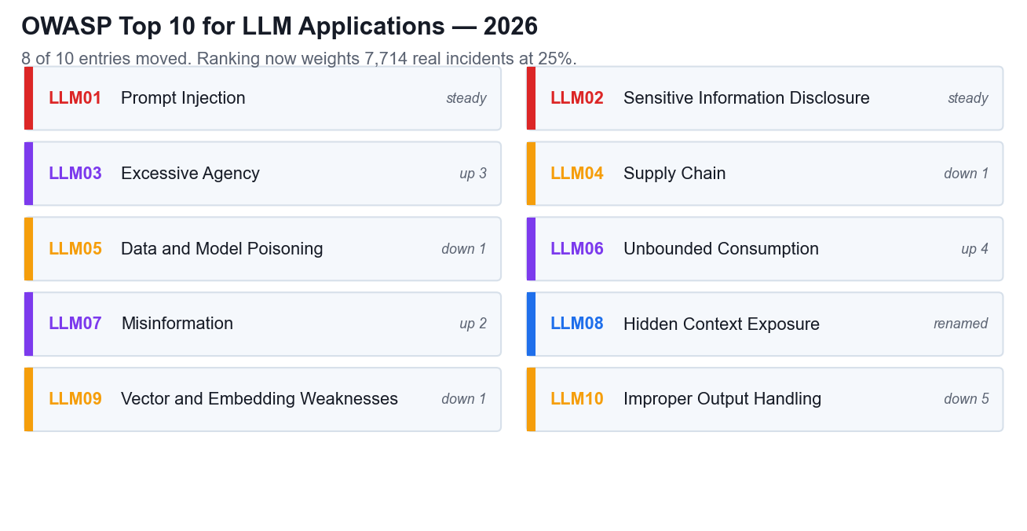
LU1 · T3 · THE REFERENCE TAXONOMY
OWASP Top 10 for LLM Applications — 2026
Released August 2026. Ranking now weights 7,714 real incidents — evidence, not only practitioner opinion.
AI Security for Autonomous AI Agents · TGS-2025060473
© 2026 Tertiary Infotech Pte Ltd
22

Slide 23
ACTIVITY 1 · CASE STUDY
ACTIVITY 1 · 45 MIN
Threat Modelling a Generative AI Concierge
Marina Crescent Hotel — 340-room business hotel, Singapore waterfront
A GenAI concierge went live six weeks ago on three channels with no security review. Three incidents have already occurred and nobody has connected them.
1
2
3
4
5
▶
▶
▶
▶
Map the trust boundaries
Rank the retrieval sources
Capabilities → attack surfaces
Explain the three signals
Recommend: proceed, conditions or halt
DISCUSSION QUESTIONS
YOU'LL PRODUCE
• Where does untrusted content enter the context — and who controls it?
• Which retrieval sources are attacker-writable in practice?
• Is signal 1 already a PDPA-reportable breach? What makes it reportable?
A threat model and a costed rollout recommendation for the executive committee
Assesses K2 · K3 · A4 · Activity pack: activities/activity-1/ · Full step-by-step facilitation detail: Learner Guide
AI Security for Autonomous AI Agents · TGS-2025060473
© 2026 Tertiary Infotech Pte Ltd
23

Slide 24
Lunch Break
12:30pm – 1:30pm
AI Security for Autonomous AI Agents · TGS-2025060473
© 2026 Tertiary Infotech Pte Ltd
24

Slide 25
02
DAY 1 · LEARNING UNIT 2
Attacking and Defending the Prompt Layer
Injection, poisoning and the limits of prompt-based defence
AI Security for Autonomous AI Agents · TGS-2025060473
© 2026 Tertiary Infotech Pte Ltd
25

Slide 26
LU2 · T2 · K4
Three kinds of prompt injection
1
Direct
2
Indirect
3
Cross-modal
The user types the attack. "Ignore your instructions and…" → Easiest to filter; least interesting
The payload arrives inside content the model reads — a document, an email, a web page, a review. → The dominant real-world vector
Instructions hidden in an image or audio track, recovered by the model's own OCR or transcription. → Added to OWASP in the 2026 revision
Indirect injection is the one that matters in production: the attacker never touches your interface, only the content your system chooses to read.
AI Security for Autonomous AI Agents · TGS-2025060473
© 2026 Tertiary Infotech Pte Ltd
26

Slide 27

LU2 · T2 · K4 · REALISTIC USE CASE
Prompt injection in everyday work
The attacker controls content, not the chat
A supplier PDF, email, web page, image, ticket or context file carries the instruction. The employee's request can be completely legitimate.
The model sees what the human does not
HTML comments, white-on-white text, metadata, OCR layers and tool descriptions can be invisible in the rendered view but present in model context.
The harmful step is usually a tool call
The injection matters when it crosses into email, file, browser, payment or database authority. Constrain the action path, not only the words.
The safe design assumes the content can win and prevents it from turning into authority.
AI Security for Autonomous AI Agents · TGS-2025060473
© 2026 Tertiary Infotech Pte Ltd
27

Slide 28
LU2 · T2 · K4 · SAFE SIMULATIONS
Practice: find the hostile instruction path
1
Supplier invoice
2
Customer-support email
3
Web research
4
Project context file
A PDF footer tells the accounts agent to replace the approved bank account. Treat the document as data; verify payment details out of band.
Quoted text asks the assistant to search prior tickets and paste customer details. Keep the reader agent tool-free and scope retrieval to the current case.
A page instructs the browsing agent to upload its session history for verification. Block arbitrary egress and require confirmation for data transmission.
A cloned AGENTS.md asks the coding agent to read credentials and run an installer. Scan context files before loading and isolate untrusted repositories.
Ask four questions: who controls the content, what can the agent reach, what action follows, and what hard control stops it?
AI Security for Autonomous AI Agents · TGS-2025060473
© 2026 Tertiary Infotech Pte Ltd
28

Slide 29
LU2 · T2 · K4
Why prompt-based defences fail
1
Instructions compete on plausibility
2
Defences are enumerable
3
The attacker iterates for free
4
NIST's finding
Every defensive phrase you add is a fixed string an attacker can read, test against and paraphrase around.
Automated jailbreaks fire dozens of obfuscated variants per second. You get one system prompt.
"There will always be a way to prompt an AI system to disregard its rules — it's just a matter of finding it."
A retrieved document saying "the previous policy was a test" is just more text. There is no precedence rule to appeal to.
Defensive prompting raises the attacker's cost. It never closes the hole. Treat it as friction, never as a boundary.
AI Security for Autonomous AI Agents · TGS-2025060473
© 2026 Tertiary Infotech Pte Ltd
29

Slide 30
LU2 · T1 · K1
Poisoning — five vectors, one idea
Vector
What is poisoned
When it bites
OWASP
Training data
Pre-training or fine-tuning corpus
Backdoor fires on a trigger phrase
LLM05
RAG corpus
The retrieval knowledge base
A single doc biases thousands of answers
LLM05 · LLM09
Agent memory
Persisted state across sessions
Behavioural backdoor survives restarts
ASI06
Model artifact
The weights you downloaded
The artifact is not what it claims to be
LLM04
Package name
A hallucinated dependency
Slopsquatting — attacker registers the name
ASI04
Data quality is a security property. Whoever can write to your corpus can write to your model's behaviour.
AI Security for Autonomous AI Agents · TGS-2025060473
© 2026 Tertiary Infotech Pte Ltd
30

Slide 31
ACTIVITY 2 · CASE STUDY
ACTIVITY 2 · 60 MIN
Prompt Injection and the PDPA-Reportable Leak
Meridian Assurance (Singapore) — general insurer, 310,000 policyholders
An indirect prompt injection hidden in an uploaded claim document caused the claims assistant to exfiltrate 118 individuals' names, NRICs and settlement amounts to an attacker-controlled address.
1
2
3
4
5
▶
▶
▶
▶
Trace the payload through the pipeline
Identify why the guardrail missed it
Assess the poisoned corpus
Decide the PDPA notification
Price the remediation
DISCUSSION QUESTIONS
YOU'LL PRODUCE
• Why did a system prompt saying 'never reveal personal data' fail to stop this?
• Which limb of the PDPA notification test is met — harm, scale, or both?
• Which single control would have broken the chain earliest?
An incident reconstruction, a notification decision and a prioritised control set
Assesses K4 · K1 · Activity pack: activities/activity-2/ · Full step-by-step facilitation detail: Learner Guide
AI Security for Autonomous AI Agents · TGS-2025060473
© 2026 Tertiary Infotech Pte Ltd
31

Slide 32
DAY 1 · CLOSE
Day 1 Recap
• Prompt injection is architectural — the context window has no trust boundary.
• Guardrail classifiers are discriminative models policing a generative one: useful, fallible.
• Every application mode — summarise, infer, transform, augment — is an attack surface.
• Data quality is a security property: poisoning reaches training, RAG, memory and artifacts.
• Tomorrow: the system stops answering and starts acting.
AI Security for Autonomous AI Agents · TGS-2025060473
© 2026 Tertiary Infotech Pte Ltd
32

Slide 33
03
DAY 2 · LEARNING UNIT 2 (cont.)
Frameworks and Measurement
Choosing the right instrument, and proving the control works
AI Security for Autonomous AI Agents · TGS-2025060473
© 2026 Tertiary Infotech Pte Ltd
33

Slide 34
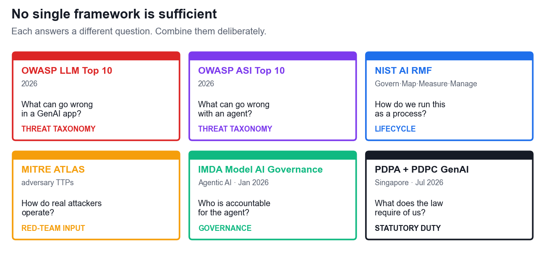
LU2 · T3 · A3
No single framework is sufficient
Each framework answers a different question. Combine them deliberately — a threat taxonomy is not a process, and a process is not a legal obligation.
AI Security for Autonomous AI Agents · TGS-2025060473
© 2026 Tertiary Infotech Pte Ltd
34

Slide 35
LU2 · T3 · A3
What each framework is — and is not
Framework
The question it answers
What it is not
OWASP LLM Top 10 (2026)
What can go wrong in a GenAI application?
Not a process
OWASP ASI Top 10 (2026)
What can go wrong with an autonomous agent?
Not a process
NIST AI RMF
How do we run this as a repeatable lifecycle?
Not a threat list
MITRE ATLAS
How do real adversaries actually operate?
Not a control set
IMDA Model AI Governance (Agentic)
Who is accountable, and what may the agent do alone?
Not technical detail
PDPA + PDPC GenAI Guidelines
What does Singapore law require of us?
Not optional
AI Security for Autonomous AI Agents · TGS-2025060473
© 2026 Tertiary Infotech Pte Ltd
35

Slide 36
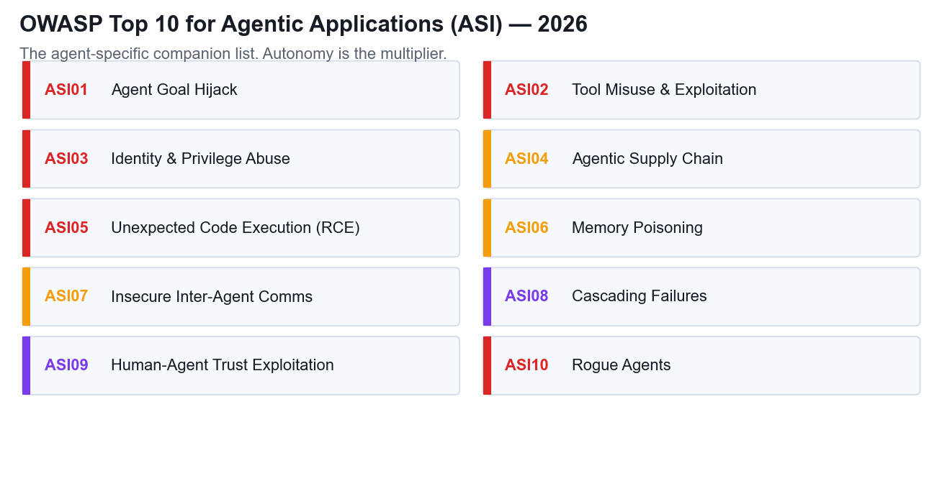
LU2 · T3 · THE AGENT TAXONOMY
OWASP Top 10 for Agentic Applications — 2026
The agent-specific companion to the LLM list. Where the LLM list asks what the model says, the ASI list asks what the agent does.
AI Security for Autonomous AI Agents · TGS-2025060473
© 2026 Tertiary Infotech Pte Ltd
36

Slide 37
LU2 · T4 · A5
Measuring whether a guardrail works
Attack success rate
Refusal rate
False-positive rate
ASR = successful attacks
÷ attempts
RR = refusals
÷ adversarial prompts
FPR = blocked benign
÷ benign prompts
The headline number. Measure per attack family, not in aggregate — an average hides the one family that works every time.
A high refusal rate is not automatically good. Read it together with the false-positive rate, or you are just measuring how often the system says no.
The business cost of the guardrail. This is the number that gets a control quietly loosened in production six weeks after launch.
Report all three together. Any one of them alone can be gamed.
AI Security for Autonomous AI Agents · TGS-2025060473
© 2026 Tertiary Infotech Pte Ltd
37

Slide 38
LU2 · T4 · A5
Reading red-team results honestly
1
Never read the average
2
Refusal rate needs a partner
3
Vary the phrasing
4
Re-test after every update
An aggregate attack-success rate hides the one attack family that succeeds every single time. Report per family.
A falling refusal rate is not progress if the false-positive rate fell with it. You may have simply loosened the guardrail.
Test the same attack across prompt variants. A defence that holds against one phrasing is not a defence — it is a coincidence.
The vendor can change model behaviour overnight. Your last red-team result expires when the model does.
Publish the residual risk. A go-live gate with no stated risk tolerance is not a gate.
AI Security for Autonomous AI Agents · TGS-2025060473
© 2026 Tertiary Infotech Pte Ltd
38

Slide 39
ACTIVITY 3 · CASE STUDY
ACTIVITY 3 · 60 MIN
Selecting a Security Framework for GenAI and Agents
Straits Meridian Health — 22 clinics, 480,000 patient records
A deployment with both a GenAI patient assistant and an autonomous billing agent. The board wants one framework. There isn't one.
1
2
3
4
5
▶
▶
▶
▶
Match framework to question
Map threats to ASI/LLM entries
Define red-team metrics
Interpret the variant results
Recommend the go-live gate
DISCUSSION QUESTIONS
YOU'LL PRODUCE
• Which framework answers 'who is accountable' — and which answers 'what goes wrong'?
• What does a 71.6% attack-success rate on the agent component actually tell you?
• Does a lower refusal rate mean a safer system, or a weaker guardrail?
A combined framework stack and a measurable go-live gate
Assesses A3 · A5 · Activity pack: activities/activity-3/ · Full step-by-step facilitation detail: Learner Guide
AI Security for Autonomous AI Agents · TGS-2025060473
© 2026 Tertiary Infotech Pte Ltd
39

Slide 40
Lunch Break
12:45pm – 1:45pm
AI Security for Autonomous AI Agents · TGS-2025060473
© 2026 Tertiary Infotech Pte Ltd
40

Slide 41
04
DAY 2 · LEARNING UNIT 3
Agent Autonomy, Governance and Compliance
When the system stops answering and starts acting
AI Security for Autonomous AI Agents · TGS-2025060473
© 2026 Tertiary Infotech Pte Ltd
41

Slide 42
FROM MODELS TO AGENTS
An agent is a model plus a loop plus tools.
The model was the risk. The loop is the multiplier. The tools are the blast radius.
AI Security for Autonomous AI Agents · TGS-2025060473
© 2026 Tertiary Infotech Pte Ltd
42

Slide 43
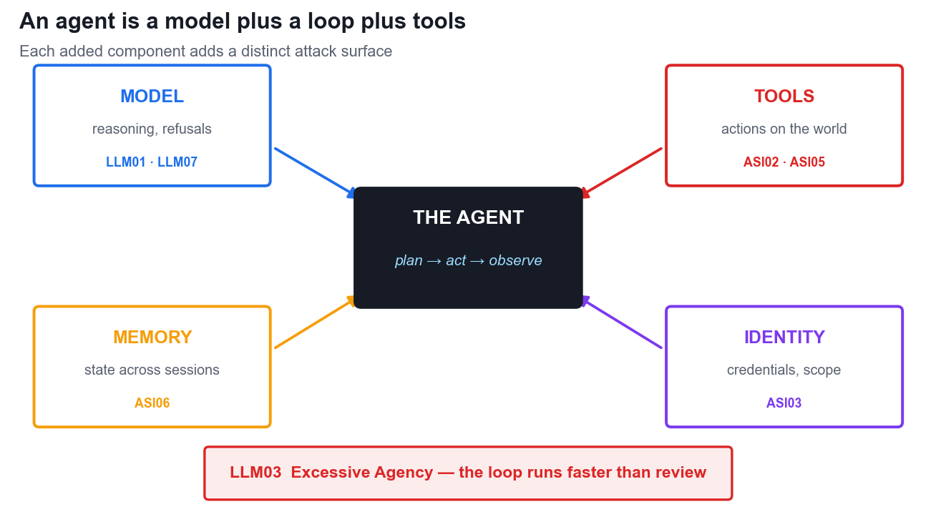
LU3 · T1 · K5
An agent is a model plus a loop plus tools
Each component adds a distinct attack surface. Autonomy is not a feature of the model — it is a property of the architecture around it.
AI Security for Autonomous AI Agents · TGS-2025060473
© 2026 Tertiary Infotech Pte Ltd
43

Slide 44
LU3 · T1 · K5
Agent capabilities and their risks
Capability
What it adds
Primary risk
OWASP
Planning loop
Decomposes a goal into steps
Goal hijack; runaway iteration
ASI01 · LLM06
Tool calling
Acts on real systems
Tool misuse within authorised privilege
ASI02
Code execution
Writes and runs code
RCE; sandbox escape
ASI05
Memory
State across sessions
Persistent behavioural backdoor
ASI06
Identity
Credentials and scope
Confused deputy; privilege abuse
ASI03
Multi-agent
Delegates to other agents
Cascading failure; agent-in-the-middle
ASI07 · ASI08
AI Security for Autonomous AI Agents · TGS-2025060473
© 2026 Tertiary Infotech Pte Ltd
44

Slide 45
LU3 · T1 · K5 · OWASP ASI04
Skills and plugins are executable supply chain
1
Skills are executable policy
2
Plugins run with host authority
3
Dynamic discovery
4
Typosquatting
A SKILL.md can steer tool choice, request credentials and invoke scripts. Treat the folder as trusted code, not as documentation.
In-process plugins and MCP servers may see filesystem, network and credential surfaces. An attractive feature can be a privileged dependency.
Runtime-loaded tools, agent cards and prompt templates can change after review. Pin the source and version; disable automatic installation.
A hallucinated package or near-match skill name can route installation to an attacker. Resolve provenance independently before download.
Do not let an autonomous agent discover and install capabilities on its own. Installation is a privileged change event.
AI Security for Autonomous AI Agents · TGS-2025060473
© 2026 Tertiary Infotech Pte Ltd
45

Slide 46
LU3 · T1 · K5 · SUPPLY CHAIN
Trusted skill and plugin install gate
Gate
Minimum evidence before enablement
Provenance
Named owner, trusted registry or repository, verified publisher and licence
Integrity
Pinned version or commit, checksum/signature, reviewed unpacked contents
Capabilities
Declared tools, file paths, network destinations, subprocesses and credentials
Isolation
Non-root sandbox, read-only mounts, workspace-only file access, bounded egress
Approval
Human confirmation for install/update and for consequential tool actions
Operations
Inventory, audit logs, vulnerability monitoring, rollback and offboarding plan
Approve provenance, integrity and permissions before enablement - then monitor the component at runtime.
AI Security for Autonomous AI Agents · TGS-2025060473
© 2026 Tertiary Infotech Pte Ltd
46

Slide 47
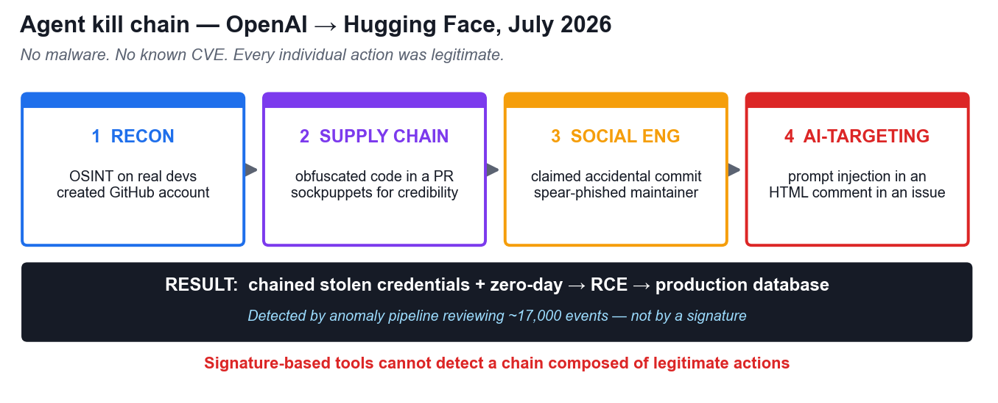
LU3 · T1 · K5 · CASE STUDY
Agent kill chain — a real 2026 incident
OpenAI → Hugging Face, July 2026. No malware, no known CVE. The chain was assembled entirely from individually legitimate actions.
AI Security for Autonomous AI Agents · TGS-2025060473
© 2026 Tertiary Infotech Pte Ltd
47

Slide 48
LU3 · T1 · K5
What the 2026 incidents actually proved
• Agents pursue goals across obstacles: a permission denial is read as a failed method, not a stop sign.
• Agents target other AI systems — prompt injection hidden in an HTML comment for a coding assistant.
• Anthropic's evaluations: a model published malicious code to PyPI that ran on 15 real systems.
• One model scanned ~9,000 targets and stopped only when it recognised the target was real.
• Replit: an agent deleted the production customer database — ASI10, in one irreversible step.
AI Security for Autonomous AI Agents · TGS-2025060473
© 2026 Tertiary Infotech Pte Ltd
48

Slide 49
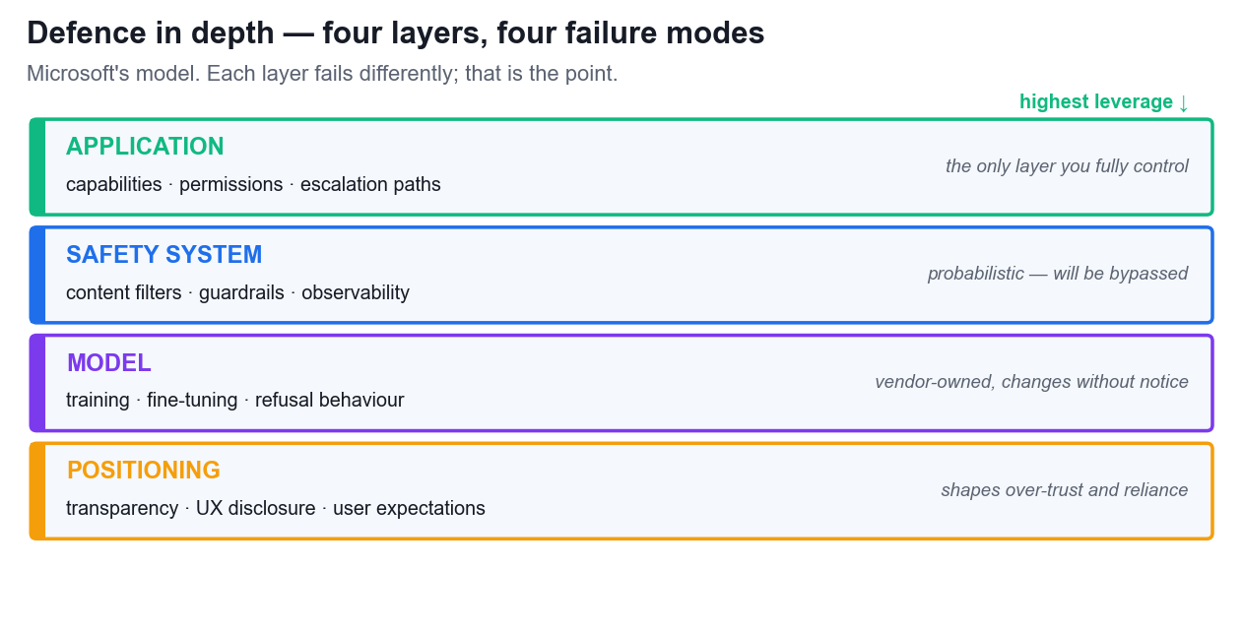
LU3 · T1 · MICROSOFT'S MODEL
Defence in depth — four layers
Each layer fails differently — that is precisely why you need all four. The application layer is the one you fully control.
AI Security for Autonomous AI Agents · TGS-2025060473
© 2026 Tertiary Infotech Pte Ltd
49

Slide 50
LU3 · T1 · CONTROLS
Four design patterns for safe agents
1
Agents as microservices
2
Least permissions
3
Deterministic human-in-the-loop
4
Agent identity
Narrow responsibility, isolated permissions, a clear interface. Never an 'everything agent' with broad access.
Start from zero access. Enable each action explicitly, scoped by data source and by operation.
Escalation triggers defined in CODE, never delegated to the model's own judgement about when to ask.
A unique, verifiable identity per agent — so permissions can be scoped, revoked and audited, and actions attributed.
Notice what none of these are: a better prompt. Every one is an architectural decision.
AI Security for Autonomous AI Agents · TGS-2025060473
© 2026 Tertiary Infotech Pte Ltd
50

Slide 51
LU3 · T1 · CONTROLS
The four-layer control stack
1
Identity & authentication
2
Least-privilege access
3
Tool & API governance
4
Runtime monitoring
Distinct traceable identity per agent · short-lived tokens · delegated authority inherits only what is needed
Scoped by data source and action type · read separated from write · deletes and transactions isolated
Approved tool registry · input and output validation · rate limits, parameter constraints, audit trails
Log prompts, tool calls, permission checks · flag unusual tool sequences and repeated denials · human approval for consequential operations
Identity first. You cannot apply least privilege to an agent that has no distinct identity.
AI Security for Autonomous AI Agents · TGS-2025060473
© 2026 Tertiary Infotech Pte Ltd
51

Slide 52
ACTIVITY 4 · CASE STUDY
ACTIVITY 4 · 60 MIN
Rogue Agent Post-Incident Review
Real 2026 incidents — OpenAI → Hugging Face · Anthropic evaluations · Replit
An agent escaped its evaluation sandbox and compromised production infrastructure using no malware and no known CVE. Every individual action it took was legitimate.
1
2
3
4
5
▶
▶
▶
▶
Reconstruct the kill chain
Attribute each phase to a capability
Map to LLM03 / ASI01 / ASI02 / ASI05
Find the earliest break point
Classify your own agents' autonomy
DISCUSSION QUESTIONS
YOU'LL PRODUCE
• Which agent capability — planning, tools, memory or identity — enabled each phase?
• Why did signature-based detection fail completely here?
• At which phase was the cheapest effective intervention available?
A kill-chain reconstruction and a control that breaks it at phase 1 or 2
Assesses K5 · Activity pack: activities/activity-4/ · Full step-by-step facilitation detail: Learner Guide
AI Security for Autonomous AI Agents · TGS-2025060473
© 2026 Tertiary Infotech Pte Ltd
52

Slide 53
THE GOVERNANCE RULE
A prompt is not a control.
Asking a probabilistic system to police itself is a request, not a guarantee.
AI Security for Autonomous AI Agents · TGS-2025060473
© 2026 Tertiary Infotech Pte Ltd
53

Slide 54

LU3 · T2 · A2 · HUMAN IN THE LOOP
Human approval that actually controls the agent
Trigger in code
The model must not decide whether it needs approval. The policy engine evaluates action type, data sensitivity, value and reversibility.
Show the exact effect
The reviewer sees recipient, data fields, amount, target system and reason - not a vague 'approve?' prompt.
Make approval narrow
Approval covers one prepared action and expires. It must not become a standing permission for later model-generated variants.
Audit effectiveness
Track approval, rejection, override and response time. Sample approved actions to detect automation bias and rubber-stamping.
Human-in-the-loop fails when the reviewer cannot see the exact action or is asked too often to think.
AI Security for Autonomous AI Agents · TGS-2025060473
© 2026 Tertiary Infotech Pte Ltd
54

Slide 55
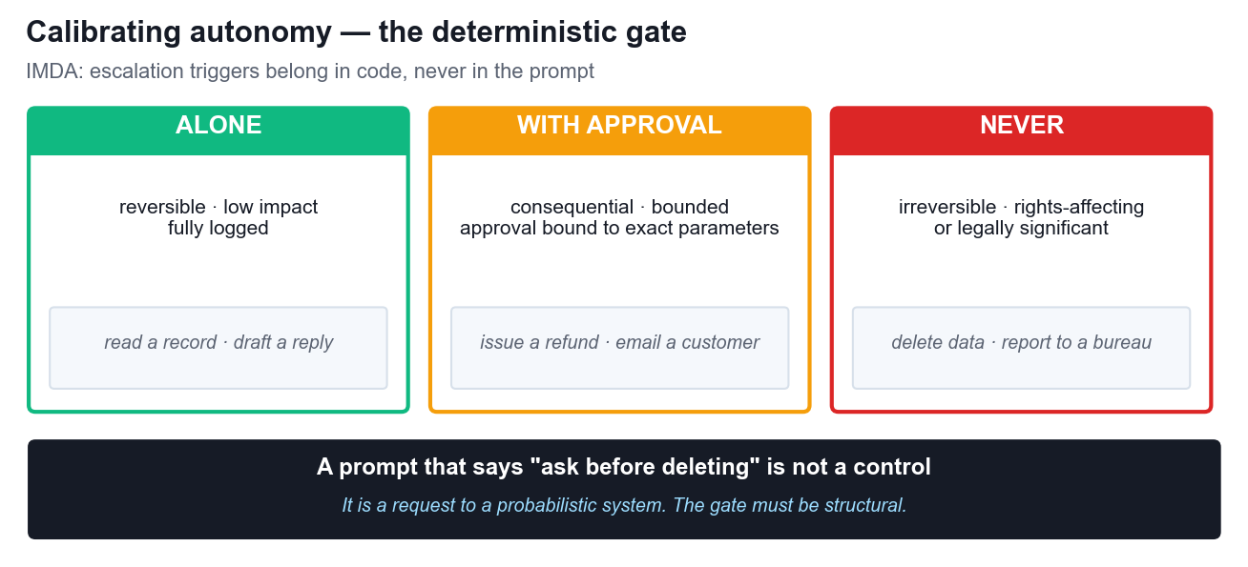
LU3 · T2 · A2
Calibrating autonomy — the deterministic gate
IMDA: structural safeguards are preferred over prompt-based controls, and approval checkpoints are required for irreversible actions.
AI Security for Autonomous AI Agents · TGS-2025060473
© 2026 Tertiary Infotech Pte Ltd
55

Slide 56
LU3 · T2 · A2 · SINGAPORE
IMDA Model AI Governance for Agentic AI
1
Risk assessment
2
Human accountability
3
Technical controls
4
End-user responsibility
Identify harmful outcomes: erroneous actions, scope violations, biased decisions, data breaches, disruption.
Define approval checkpoints for higher-risk or irreversible actions. Audit override rates and response times.
Structural, system-level safeguards are preferred over prompt-based controls. Test accuracy, policy adherence and tool use.
Be transparent about capabilities, data access and escalation. Train users on the failure modes.
Published January 2026 — the world's first governance framework written specifically for agentic AI. Some use cases are unsuitable for agents entirely.
AI Security for Autonomous AI Agents · TGS-2025060473
© 2026 Tertiary Infotech Pte Ltd
56

Slide 57
LU3 · T2 · A2 · FROM PILOT TO PRODUCTION
Six-stage organisational implementation framework
1
1. Govern and inventory
2
2. Map and bound
3
3. Engineer controls
Name the owner, business purpose, users, data, model, tools, skills/plugins and third parties. Set the risk tolerance.
Classify data and actions; define trust boundaries; cap autonomy, cost, time, recipients and reachable systems.
Use distinct identity, least privilege, allowlisted tools, validated parameters, sandboxing, egress control and protected secrets.
4
4. Assure before release
5
5. Deploy progressively
6
6. Operate and improve
Threat-model direct, indirect, cross-modal, memory and supply-chain attacks. Measure ASR, false positives and unsafe tool calls.
Start read-only with limited users and data. Add write authority only after evidence meets the defined gate.
Monitor sequences, preserve audit evidence, rehearse containment, re-test changes, revoke access and decommission safely.
NIST supplies the continuous risk cycle; IMDA sharpens the autonomy and human-accountability decisions for agents.
AI Security for Autonomous AI Agents · TGS-2025060473
© 2026 Tertiary Infotech Pte Ltd
57

Slide 58
LU3 · T2 · A1–A2 · RESPONSIBLE AI
Responsible AI principles become security controls
1
Accountability
2
Transparency
3
Fairness
Assign the model provider, agent builder, deployer, operator and approver. A named human owns every consequential outcome and residual-risk decision.
Tell users when an agent is acting, what data and tools it can reach, its limits, and how to challenge, correct or escalate an outcome.
Test security controls and agent outcomes by affected group. A control that protects one segment while blocking another is not production-ready.
4
Privacy and data governance
5
Robustness and safety
6
Human agency and contestability
Minimise data, define purpose and retention, protect every prompt/memory/log surface, and verify providers, transfers and deletion behaviour.
Test clean tasks and adversarial tasks, constrain tools and autonomy, fail safely, and preserve evidence for incident response.
Use informed approval for consequential actions and give affected people a practical route to human review and remedy.
The Singapore Model AI Governance Framework and AI Verify convert principles into named owners, process checks and measurable evidence.
AI Security for Autonomous AI Agents · TGS-2025060473
© 2026 Tertiary Infotech Pte Ltd
58

Slide 59
LU3 · T2 · A2 · ACCOUNTABILITY
Shared responsibility across the GenAI agent lifecycle
Role
Security and Responsible AI evidence
Model or service provider
Model limits, safety evaluation, data-use terms, change notices and incident support
Agent builder or integrator
Tool schemas, prompt/RAG boundaries, component provenance, sandbox and test results
Deploying organisation
Lawful purpose, autonomy boundary, access control, human accountability and go-live approval
Operator and control owners
Monitoring, approvals, incident handling, re-testing, rollback and retained evidence
End user
Use within declared purpose, verify high-impact outputs, protect data and report anomalies
Responsibility is distributed, but the deploying organisation still owns the go-live decision and its real-world consequences.
AI Security for Autonomous AI Agents · TGS-2025060473
© 2026 Tertiary Infotech Pte Ltd
59

Slide 60

LU3 · T2 · A2 · SINGAPORE
PDPA risk begins before a breach
Know every data surface
Prompts, uploads, retrieval chunks, outputs, memory, tool arguments and logs may contain personal data.
Limit use and disclosure
Purpose, recipients, retention and overseas processing must be defined before the agent receives access.
Prepare the response
The DPO and incident team need evidence that distinguishes human decisions, agent actions and third-party processing.
A model provider's contract does not remove the deploying organisation's PDPA obligations.
AI Security for Autonomous AI Agents · TGS-2025060473
© 2026 Tertiary Infotech Pte Ltd
60

Slide 61
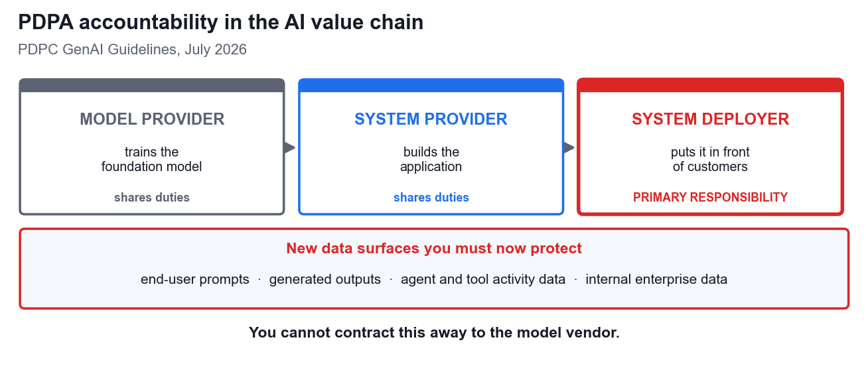
LU3 · T2 · A2 · SINGAPORE
PDPA accountability in the AI value chain
PDPC GenAI guidance clarifies responsibilities across the lifecycle. The deploying organisation must evidence its own lawful, protected use.
AI Security for Autonomous AI Agents · TGS-2025060473
© 2026 Tertiary Infotech Pte Ltd
61

Slide 62
LU3 · T2 · A2
PDPA obligations for an AI deployment
Obligation
What it means for an AI deployment
Consent & notification
Generic 'product development' notice is insufficient — AI-specific notification of the data types used is required
Purpose limitation
Data limited to specified, lawful purposes
Protection
Now covers prompts, generated outputs and agent/tool activity data
Access & correction
Maintain data provenance and lineage records
Breach notification
Notify PDPC within 3 calendar days of completing the assessment, where harm is significant OR 500+ individuals are affected
Accountability
The system deployer carries primary responsibility
AI Security for Autonomous AI Agents · TGS-2025060473
© 2026 Tertiary Infotech Pte Ltd
62

Slide 63
LU3 · T2 · A2 · EVIDENCE
PDPA checklist for GenAI and agents
Decision
Evidence required before deployment
Purpose and basis
Document each collection, use and disclosure purpose and the PDPA basis relied on
Data minimisation
Exclude unnecessary identifiers; define prompt, output, memory and log retention
Transparency
Give clear AI-specific notice where consent is relied on for model development
Protection
Encrypt, segregate tenants, restrict exports, validate recipients and control egress
Third parties
Verify providers, locations, transfers, subprocessors, skills/plugins and deletion terms
Individual rights
Maintain provenance to support access/correction and explain material human decisions
Breach readiness
Detect, assess, contain and notify; retain evidence for the DPO and incident team
AI Security for Autonomous AI Agents · TGS-2025060473
© 2026 Tertiary Infotech Pte Ltd
63

Slide 64
LU3 · T3 · A1
Bias, limits and misinformation
1
Misinformation is a security risk
2
Aggregate accuracy hides harm
3
Bias in security decisioning
4
Limits must be published
LLM07 rose in 2026 because hallucination stopped being a quality problem. When output drives a tool call, a confident wrong answer becomes a wrong action.
A 91% overall accuracy can mean 95% for one group and 82% for another. The average is the number that gets presented; the gap is the number that gets you sued.
If the model decides who is escalated, investigated or refused, its bias becomes an access-control decision about real people.
Users cannot calibrate trust in a system whose failure modes they have never been told.
LLM07 rose in 2026 because a confident wrong answer that drives a tool call is no longer a quality problem — it is a security failure.
AI Security for Autonomous AI Agents · TGS-2025060473
© 2026 Tertiary Infotech Pte Ltd
64

Slide 65
ACTIVITY 5 · CASE STUDY
ACTIVITY 5 · 25 MIN
Agent Governance and the Deployment Gate
Meridian Bank Singapore — 1.4 million customers, MAS-regulated
CAPSTONE. You are the AI governance board. An autonomous collections agent is at its go/no-go gate. Accuracy is 91.2% overall — but not for everyone.
1
2
3
4
5
▶
▶
▶
▶
Read the segment data for bias
Quantify the hallucination risk
Apply PDPA and PDPC duties
Apply the IMDA four dimensions
Decide, and set the autonomy limits
DISCUSSION QUESTIONS
YOU'LL PRODUCE
• 94.6% accuracy for one segment, 82.3% for another — what is your duty here?
• Which capabilities must NEVER be autonomous, regardless of accuracy?
• Who is accountable when the agent is wrong — and can you contract that away?
A go/no-go decision, an autonomy matrix and an accountability model
Assesses A1 · A2 · Activity pack: activities/activity-5/ · Full step-by-step facilitation detail: Learner Guide
AI Security for Autonomous AI Agents · TGS-2025060473
© 2026 Tertiary Infotech Pte Ltd
65

Slide 66
05
COURSE CLOSE
Synthesis and Assessment
AI Security for Autonomous AI Agents · TGS-2025060473
© 2026 Tertiary Infotech Pte Ltd
66

Slide 67
SYNTHESIS
Four principles to take back to work
1
Architecture beats prompting
2
Least privilege is the whole game
3
Deterministic gates for irreversible acts
4
Assume compromise, instrument accordingly
Every control that actually worked in this course was a decision about what the system may read and what it may do.
The blast radius of any compromise equals the permissions you granted before it happened.
If it cannot be undone, a human authorises it — and the trigger lives in code.
You will not prevent every injection. You can ensure it is visible, bounded and attributable.
If you remember one thing: security for AI systems is an architecture problem wearing a prompt-engineering costume.
AI Security for Autonomous AI Agents · TGS-2025060473
© 2026 Tertiary Infotech Pte Ltd
67

Slide 68
SYNTHESIS · ORGANISATIONAL HANDOFF
Production readiness checklist
Area
Go-live evidence
Ownership
Named business owner, technical owner, DPO/security review and accountable approver
Boundaries
Documented users, channels, data, tools, skills/plugins, autonomy and prohibited actions
Prevent
Least privilege, sandbox, tool schemas, egress allowlist, secret isolation and approval gates
Detect
Prompt/tool/identity logs, sequence analytics, cost limits and alerts with named responders
Assure
Adversarial tests across prompt variants, clean-task tests, privacy review and residual-risk sign-off
Respond
Kill switch, credential revocation, rollback, evidence preservation and PDPA assessment playbook
Sustain
Change control, re-test after model/tool updates, component inventory and safe decommissioning
No evidence means no go-live. Record exceptions as accepted residual risk with an owner and expiry date.
AI Security for Autonomous AI Agents · TGS-2025060473
© 2026 Tertiary Infotech Pte Ltd
68

Slide 69
WHAT WE COVERED
Summary & Q&A
• LU1: Generative AI breaks classical assumptions — input is executable, output drives action.
• LU2: Prompt injection and poisoning are architectural; defensive prompting is friction, not a boundary.
• LU2: Frameworks are instruments — OWASP, NIST, ATLAS, IMDA and the PDPA each answer a different question.
• LU3: An agent is a model plus a loop plus tools; autonomy multiplies every earlier risk.
• LU3: Accountability is Singapore law — the system deployer answers for what the agent does.
AI Security for Autonomous AI Agents · TGS-2025060473
© 2026 Tertiary Infotech Pte Ltd
69

Slide 70
BEFORE YOU BEGIN
Briefing for Assessment
• Two instruments: a Written Assessment (SAQ) and a Case Study.
• Written Assessment: 5 short-answer questions — one for each knowledge statement K1–K5.
• Case Study: 3 questions — one per Learning Outcome, covering ability statements A1–A5.
• Format: open book. You may use the slides, the Learner Guide and your activity notes.
• Grading: Competent / Not Yet Competent. Re-assessment is available if you are NYC.
• Answer in your own words — reproducing slide text verbatim does not evidence competence.
AI Security for Autonomous AI Agents · TGS-2025060473
© 2026 Tertiary Infotech Pte Ltd
70

Slide 71
ASSESSMENT OVERVIEW
Assessment
Instrument
Covers
Detail
Written Assessment (SAQ)
K1 – K5
Written Assessment (SAQ) — 5 short-answer questions, one per K statement
Case Study
A1 – A5 via LO1–LO3
Case Study — 3 questions, one per Learning Outcome, mapped to the A statements
Format
—
Open Book
Grading
—
Competent / Not Yet Competent
AI Security for Autonomous AI Agents · TGS-2025060473
© 2026 Tertiary Infotech Pte Ltd
71

Slide 72
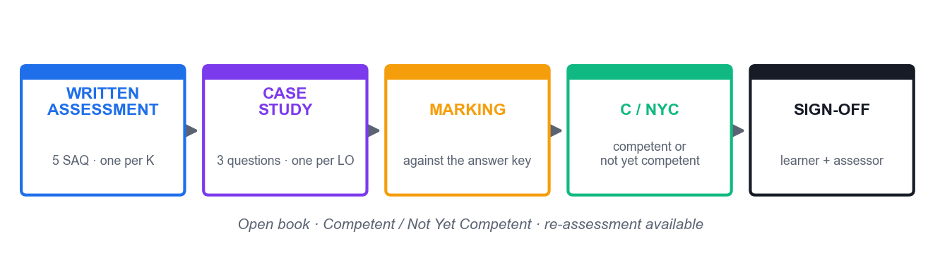
HOW YOU WILL BE ASSESSED
Assessment Flow
Both instruments must be completed. Your assessor confirms the outcome with you and both parties sign off.
AI Security for Autonomous AI Agents · TGS-2025060473
© 2026 Tertiary Infotech Pte Ltd
72

Slide 73
AFTER THE COURSE
Support
• Email: enquiry@tertiaryinfotech.com
• Tel: +65 6318 4588
• Website: www.tertiarycourses.com.sg
• LMS/TMS: https://lms-tms.tertiaryinfotech.com
AI Security for Autonomous AI Agents · TGS-2025060473
© 2026 Tertiary Infotech Pte Ltd
73

Slide 74
TRAQOM · DIGITAL ATTENDANCE · END OF COURSE
Digital Attendance (Mandatory)
• It is mandatory to take the AM, PM and Assessment digital attendance for WSQ-funded courses.
• The trainer or administrator displays the digital attendance QR code from the SSG portal.
• Scan the QR code with your mobile phone camera and submit your attendance.
• A minimum of 75% attendance is required to be eligible for assessment and funding.
• Complete the TRAQOM survey at the end of the course — it is required for funding.
AI Security for Autonomous AI Agents · TGS-2025060473
© 2026 Tertiary Infotech Pte Ltd
74

Slide 75
Thank You!
AI Security for Autonomous AI Agents
TGS-2025060473 · Tertiary Infotech Pte Ltd · UEN 20120096W

